Slide 1
Auction management system
Teemu Erkkilä, Mikko Varis, Wissam Al-dabbagh
Group 10

Slide 2
Used Kimi K2 AI for frontend layout
Frontend GitHub https://github.com/ErkkilaT/Ohjelmistotuotantoprojekti/
Backend GitHub https://github.com/NullByte3/AuctionBackend
Trello link https://trello.com/w/usertyotila67260593
Frontend image https://hub.docker.com/r/oomis1/auction_frontend
Backend image https://hub.docker.com/r/oomis1/auction_backend

Slide 3
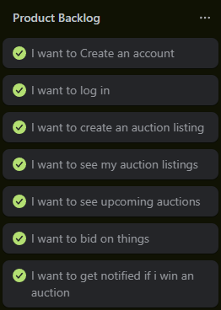
Product Backlog

Slide 4
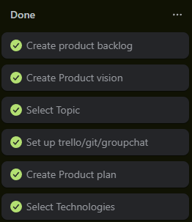

Sprint 1
Sprint Master: Teemu Erkkilä

Slide 5
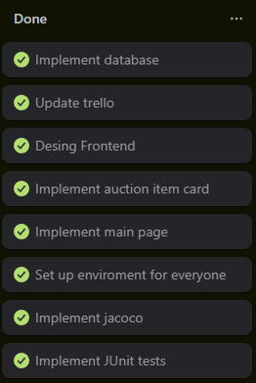
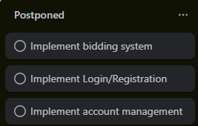
Sprint 2
Sprint Master: Mikko Varis

Slide 6
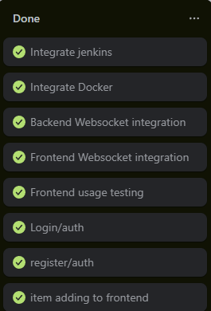
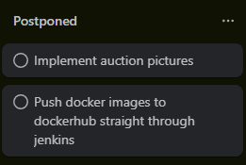
Sprint 3
Sprint Master: Wissam Al-dabbagh

Slide 7
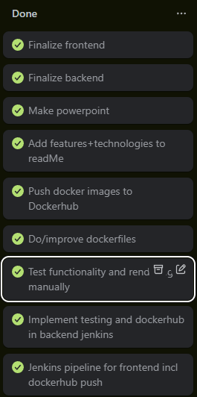
Sprint 4
Sprint Master: Teemu Erkkilä

Slide 8
Architectural Design
ER Diagram
Database schema

Slide 9
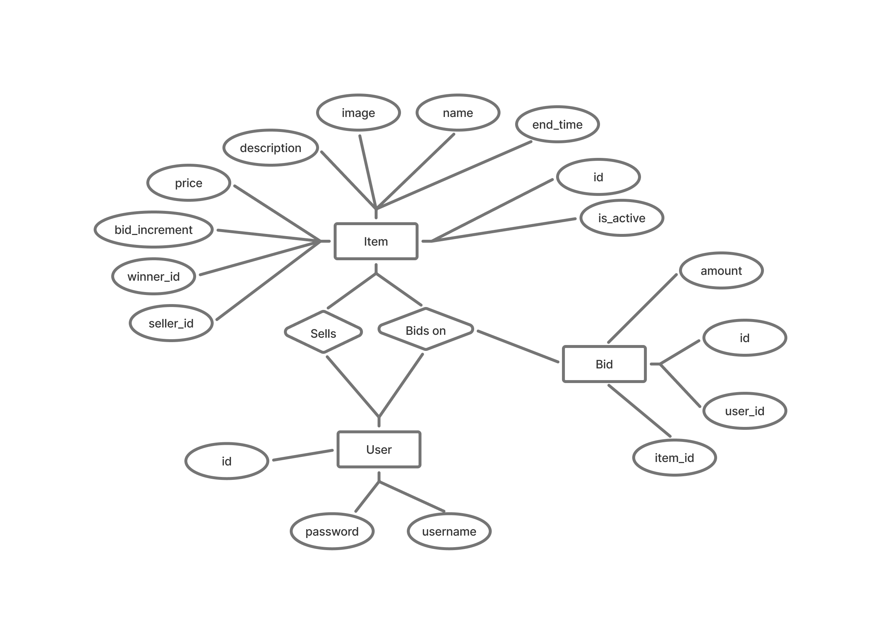
ER Diagram

Slide 10
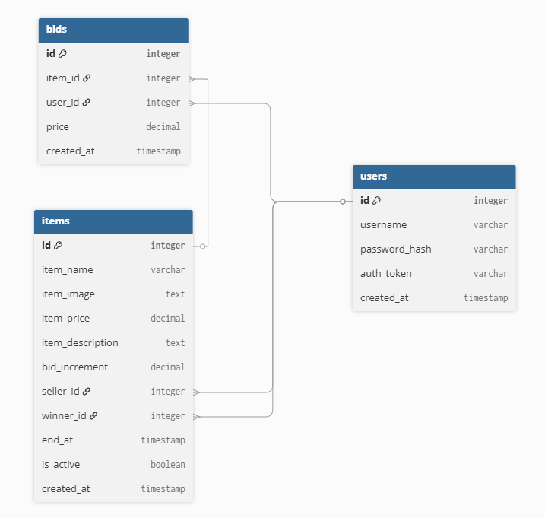
Database Schema Diagram

Slide 11
Applied Technologies
Backend
Java
Java hibernate framework
Maven
PostgreSQL
JUnit 5
Jenkins
Docker
Frontend
TypeScript
React
Tailwind
Npm
Vite
Docker
shadcn

Slide 12
Demo
5 minutes maximum
Prototype demo

Slide 13
Learning achievement
Learned a lot about building CI/CD pipelines
Learned about containerization
Learned about testing

Slide 14
Plan for further development
Improve security/sanity checks on data going to DB
Show upcoming auctions
Improve account management
Improve testing (playwright for frontend)

